Slide 1
Exam Preparation System
-Made by Group 2

Slide 2

Team Members
Saurabh Mandal
Nikhil Kumar Pujari
Ameesha Roy
Ayush Kushwaha
Shachi Shakya
Deepak B

Slide 3
Introduction
Exam Preparation System aims to help students practice and improve their skills for their exams.
They can also learn basic programming languages alongside.
Students can test their knowledge with assessments.

Slide 4
Modules
Registration/Login
Dashboard
Courses
Assessment
Settings

Slide 5


Used Technology
Frontend: Angular
Backend: Spring tool suite
Oracle Database

Slide 6
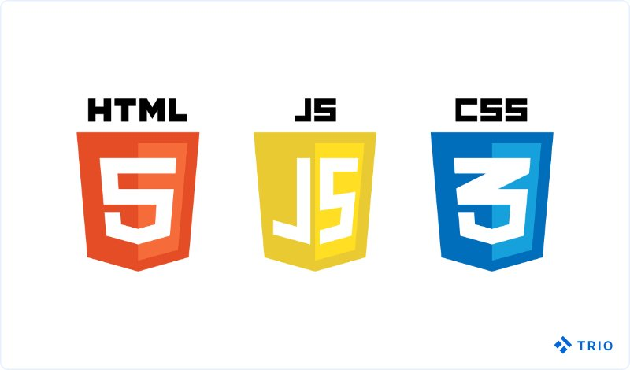
Frontend Tools
HTML
CSS
JavaScript
Typescript
Angular

Slide 7


Backend Tools
Java
Spring Boot
Spring Data JPA

Slide 8

Database
Oracle SQL

Slide 9
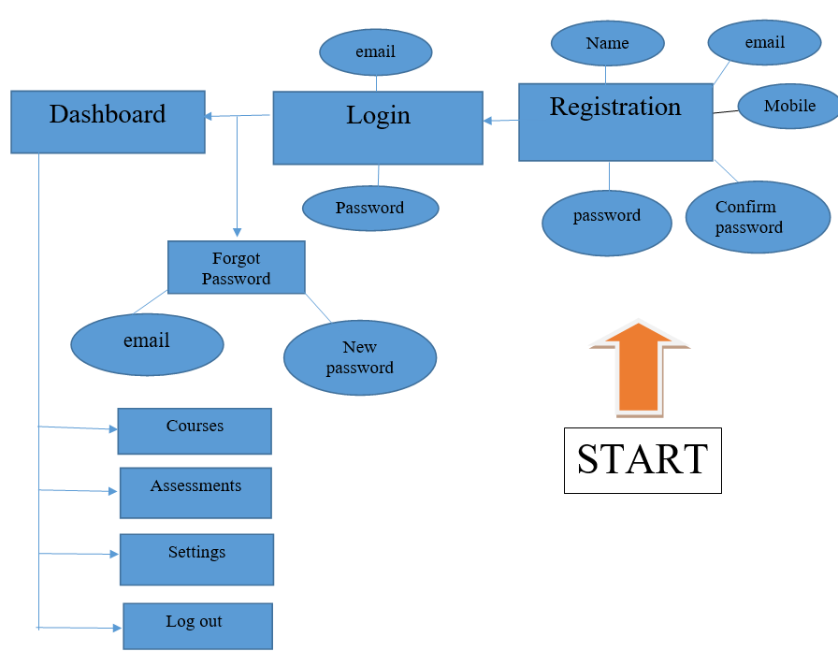
ER Diagram

Slide 10
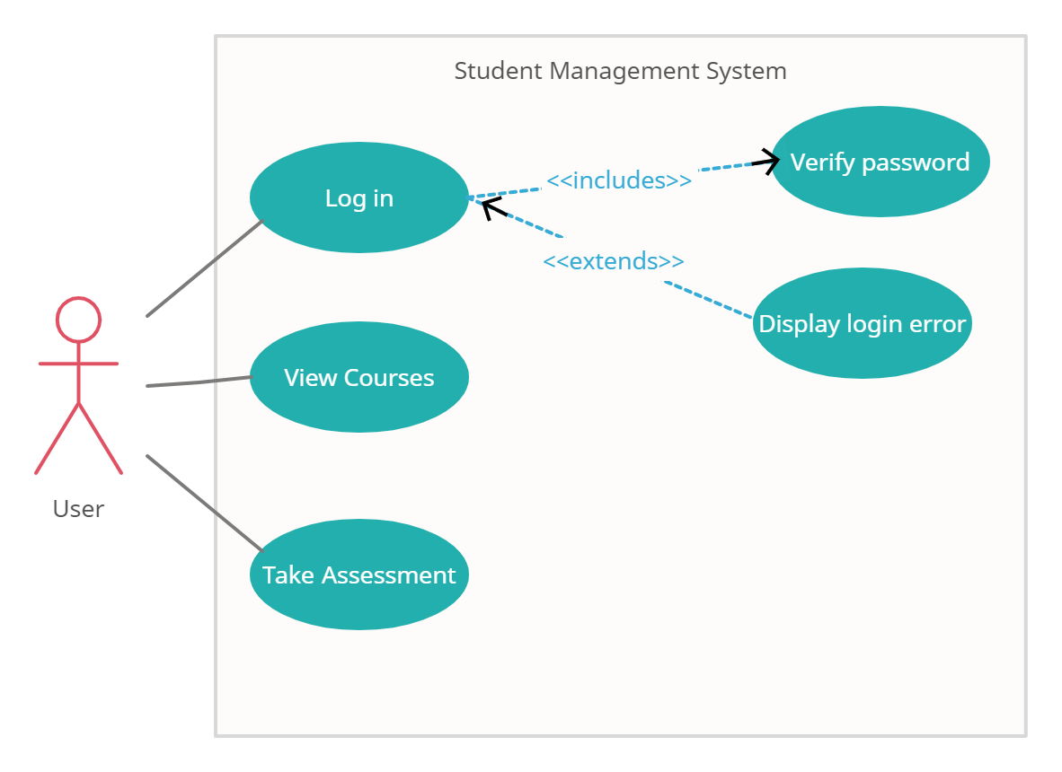
Use Case Model

Slide 11
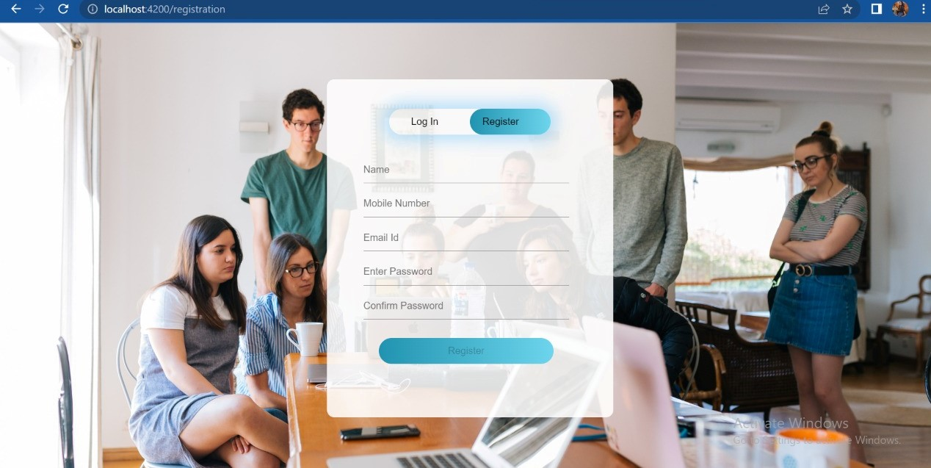
Registration

Slide 12
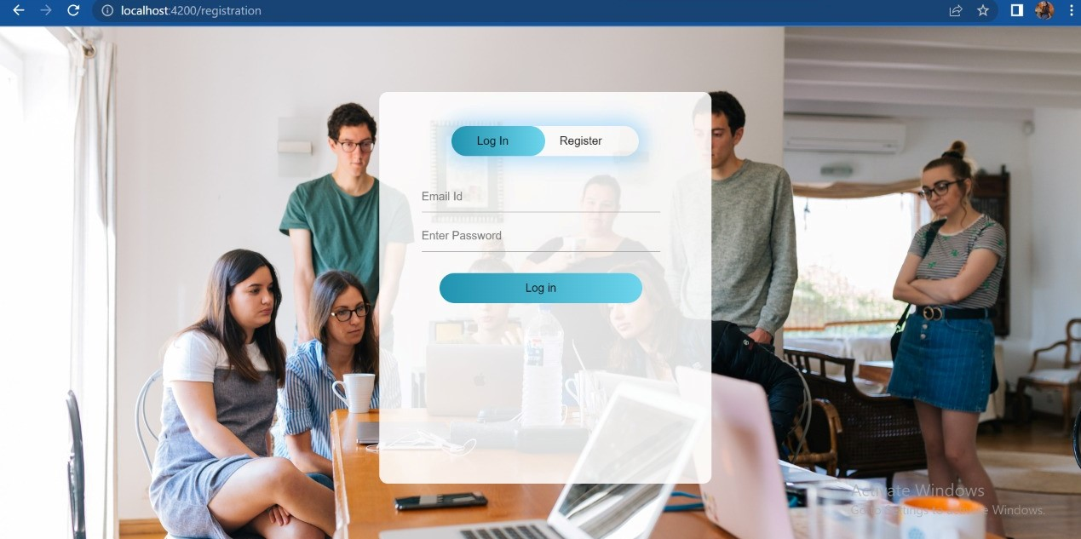
Login

Slide 13
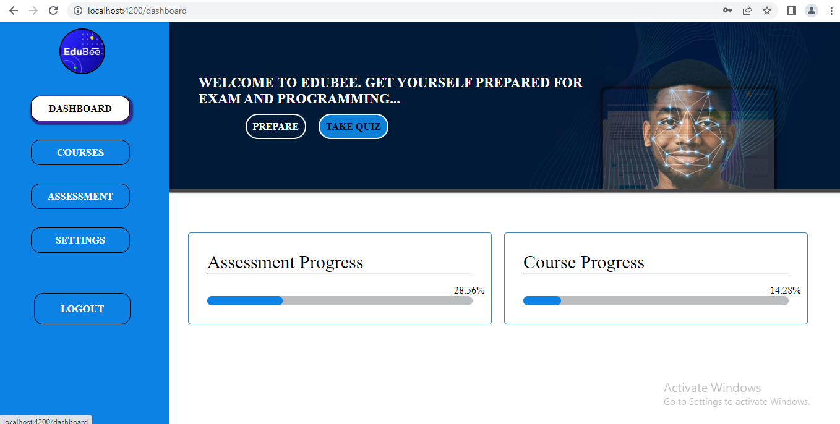
Dashboard

Slide 14
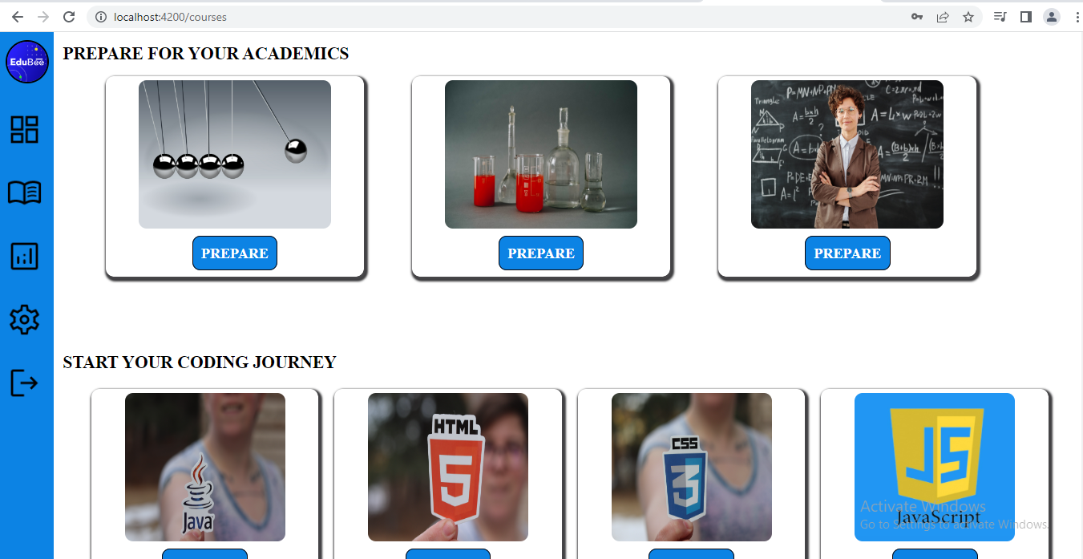
Courses

Slide 15
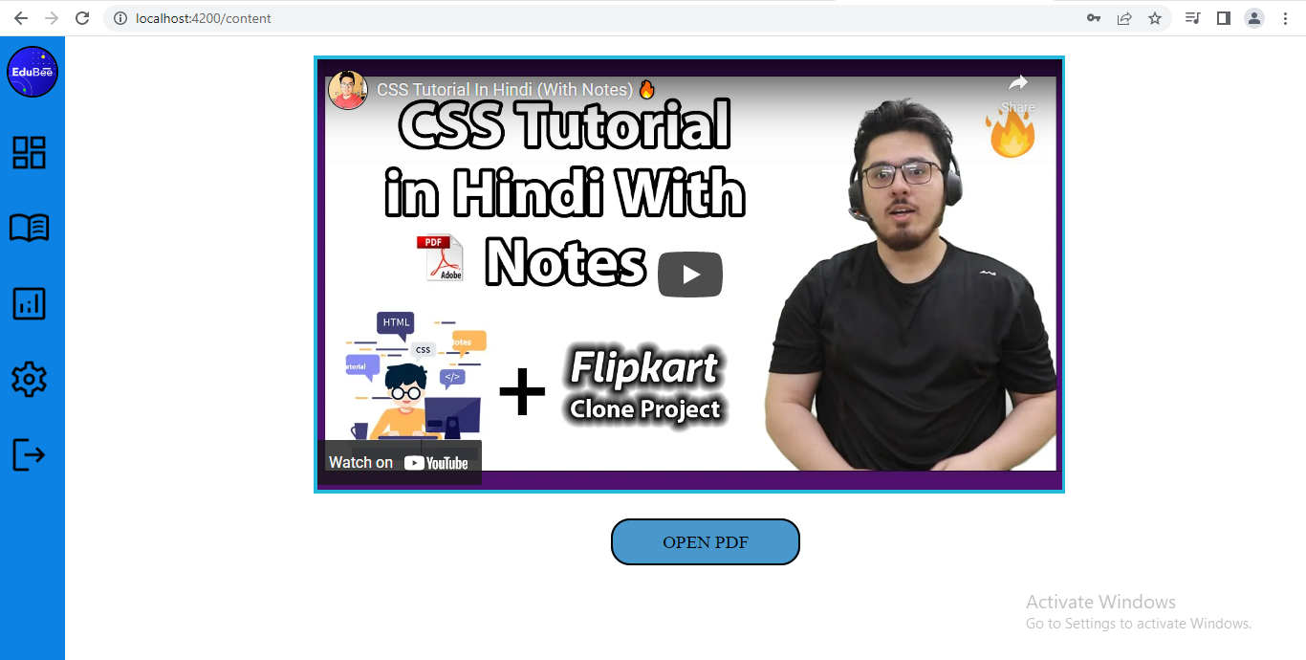
Content

Slide 16
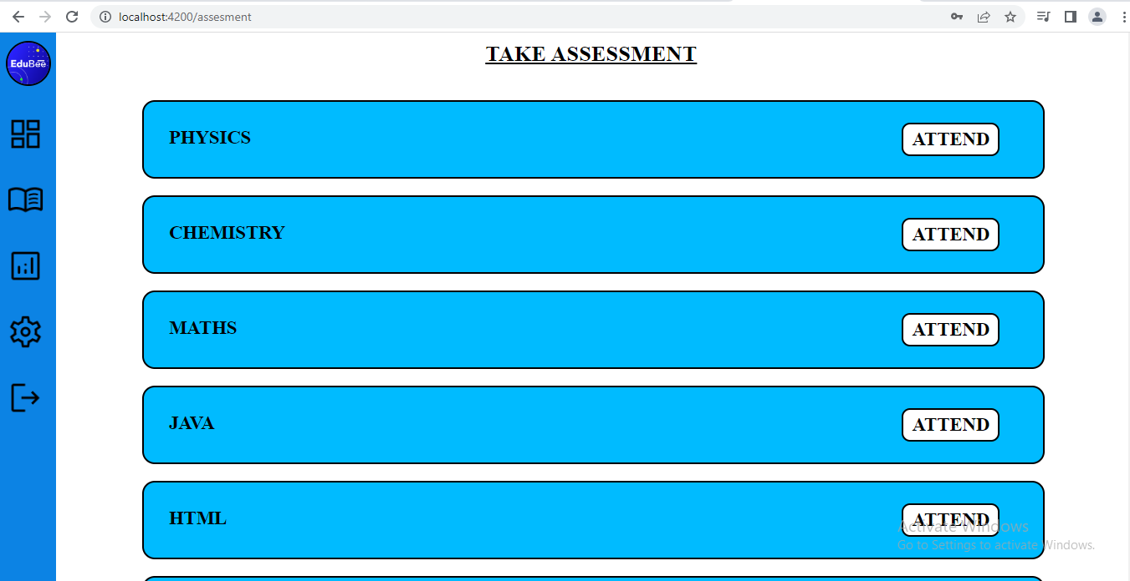
Assessment

Slide 17
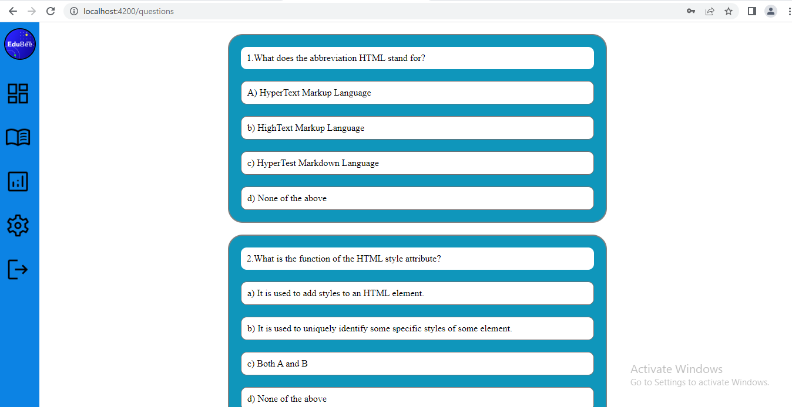
Questions

Slide 18
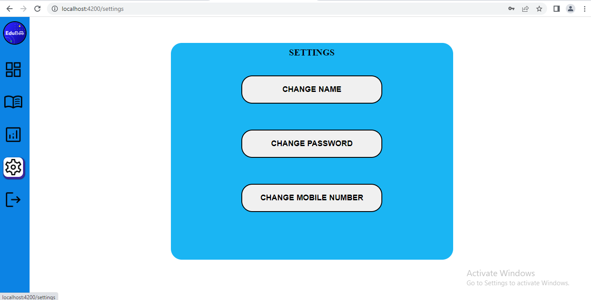
Settings

Slide 19
Thank You!

